Slide 1


ENV 103
Biodiversity

Slide 2
Biodiversity
Biodiversity :refers to the incredible variety of life found in our planet.
Biodiversity refers to the number, variety and variability of all life forms on earth. These include millions of plants, animals and micro-organisms, the genes they contain and the intricate ecosystems of which they are a part.

Slide 3
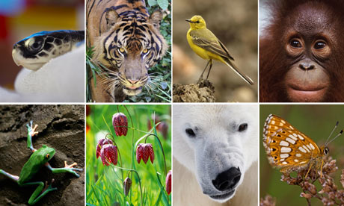
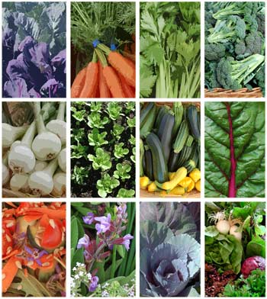
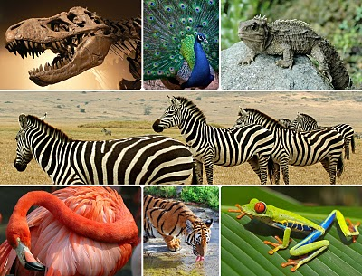

Slide 4
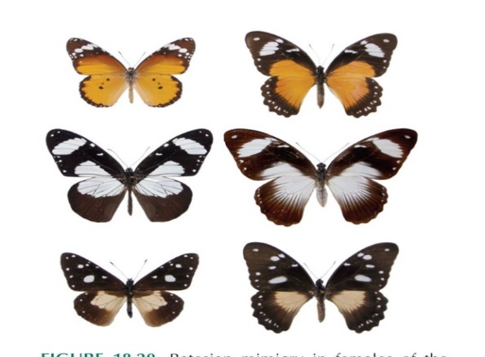
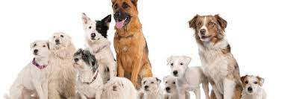
Three kinds of biodiversity –
Genetic diversity : different genes & combinations of genes within populations

Slide 5
Species diversity : describes the number of different kinds of organisms within individual communities.
Measurement of species:
Species richness: the total number of species
Species evenness: the relative abundance of species
Species dominance: the most abundant species

Slide 6
Ecological diversity : assesses the richness & complexity of a biological community
The ecosystem diversity is of great value that must be kept intact.

Slide 7
How many species are there:
1.3 million species have been identified and described,
8.7 million species live on the planet.
Extinction-
elimination of a species
Normal process of natural world
In undisturbed ecosystem rate is about one species lost every decade
Human impacts have accelerated that rate causing hundreds or perhaps thousands of species, subspecies & varieties to become extinct every year.

Slide 8
Extinctions are of two types:
Natural Extinction
Cultural Extinction
Destruction of habitat
Expansion of cities
Deforestation
Over hunting
Pollution
Global warming ( 20-30% species are at risk)
Introduction of Invasive species

Slide 9
Biological Evolution
Refer to the change in inherited characteristics of a population from generation to generation.
New species arise as a result of:
Competition for resources
Difference among individuals in their adaptations to environmental conditions

Slide 10
Ecological Niche
Ecological Niche: what is does or its profession. Role of certain species play in its ecosystem.
Niche includes:
Range of tolerance, like temperature/water availability
Resource use: food/nutrition
How it interacts with others like search for food
Role play in energy and nutrient cycling

Slide 11
Ecological Niche
Broad and narrow Niche:
Generalist species/ broad niches: can survive on varieties of food and environmental conditions. Suitable where there are huge diversity or fluctuation in environmental conditions. Human, cockroach, rats etc.
Specialized species/Narrow Niches: can tolerate narrow range of climatic and environmental condition. Polar bear, panda etc. Good for suitable environment but bad for places with fluctuations.

Slide 12
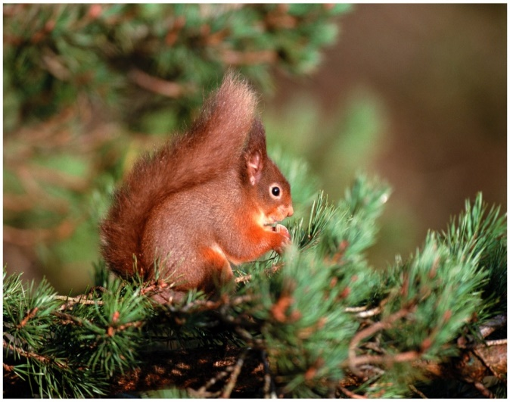
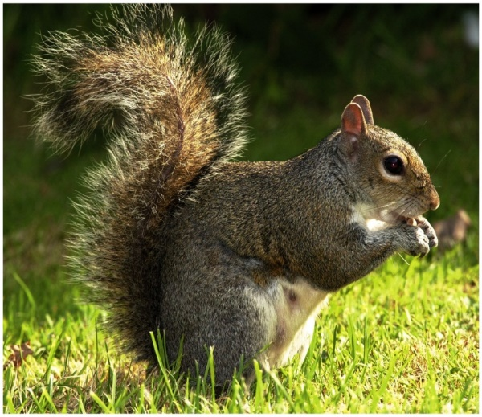
Competitive Exclusion Principle
Two species that have exactly the same requirements cannot coexist in exactly the same habitat.
Ex- British Red Squirrel and American Grey Squirrel

Slide 13
Terms related to Species Habitat
Exotic species: a species introduced into new geographic area
Endemic species: a species that is native.
Cosmopolitan species: a species with a broad distribution, occurring all over the world wherever the environment is appropriate. Example: house mouse
Ubiquitous species: species that are found almost anywhere.
Interaction between species:
Competition: usually outcome is negative for both
Symbiosis: benefits both
Predation-parasitism: benefits one affect another

Slide 14
Species at Risk
Most conservationists use the IUCN (International Union for Conservation of Nature) classification, which defines species in terms of the degree of threat they face. The main categories are:
Extinct
Possibly extinct
Endangered
Vulnerable
Rare
No longer threaten
Status unknown

Slide 15
Environmental factors that influence diversity
A. factors that tend to increase diversity
A physically diverse habitat
Moderate amounts of disturbance (fire or storm)
A small variation in environmental condition (temperature, precipitation etc.)
High diversity at one trophic level increase the diversity at another trophic level
Evolution

Slide 16
Environmental factors that influence diversity
B. factors that tend to decrease diversity
Environmental stress
Extreme environments
A severe limitations in the supply of an essential resources
Extreme amount of disturbance
Recent introduction of exotic species (species from other area)
Geographic isolation.

Slide 17
Importance of biodiversity
At least 40% of the world’s economy and 80% of the needs of poor are derived from the biological resources.
The natural environment provides the basic conditions without which humans could not survive. We need to breathe, eat, drink and shelter ourselves and we get all this from the natural world.

Slide 18
Ecological importance
Trees provide habitat and food for birds, insects, other plants and animals, fungi and micro-organism
Birds, insects and other animals serve as pollinators
Parasites and predators act as natural population controls
Various organisms, such as earthworms and bacteria are responsible for recycling organic materials and maintaining the productivity of the soils
Forests are particularly important “sinks” for the Green plants remove carbon dioxide from the atmosphere and replenish it with oxygen absorption of carbon dioxide and these are the key factors in reducing global climate change.

Slide 19
Economical importance
Food: species are hunted, fished, gathered, as well as cultivated for agriculture and aquaculture.
Fuel: timber and coal are only two examples of natural resources used to produce energy
Shelter and cloth: timber and other forest products are used as building materials for shelter. Fibers such as wool and cotton are used to make clothes
Medicines: both traditional and processed drugs are obtained from biodiversity
Other goods: paper and pencils come from raw materials provided by earth’s diversity

Slide 20
Cultural and Aesthetic
Plants and animals are often used as symbols, for example in flags, paintings, sculptures, photographs and stamps.
Biodiversity is also beautiful; it is a pleasure to see various colors of flowers in the garden and having different smell of it or to listen to birds singing etc.
Each and every living being in this earth has some role to play and has the right to exist irrespective of its usefulness to human.

Slide 21
THANK YOU

